Slide 1



ALZHEIMER’S ANALYSIS

Slide 2

AGENDA
OBJECTIVE
BACKGROUND STUDY
DATASET
METHODOLOGY
RESULTS AND DISCUSSION

Slide 3
OBJECTIVE
TO PREDICT WHETHER A PATIENT HAS ALZHEIMER’S DISEASE
TO IDENTIFY INDIVIDUALS AT RISK OF ALZHEIMER’S DISEASE.

Slide 4

4
FLOW CHART
ADVANCED RESEARCH
ALZHEIMER'S ANALYSIS
A review of existing literature related to the alzheimer's analysis
Data unification and missing value interpolation with the data.
Exploratory Data Analysis and Visualization
Different Approaches to the Problem
Comparing the models.
Dataset

Slide 5
ADVANCED RESEARCH
Research paper review
Classification is performed using three classifiers, viz. SVM, ANN and k-NN.
CONCLUSION : Here, a method is explained to compare the performance of SVM, ANN and k-NN classifiers for detecting AD. Performance comparison of classifiers with reduced features was found to be 96.29% for KKN classifier, while 92.8% for ANN and 88.51% for SVM classification.

Slide 6

DATASET
373
OBSERVATIONS
SES
MR Delay
VARIABLES
ID
EDUC
Age
MMSE
CDR
eTIV
nWBV
ASF
M/F
Hand
Group
CATEGORICAL VARIABLE

Slide 7

METHODOLOGY
DATA CLEANING
Removing unwanted columns
Handling unknown Values
Factorizing the variables

Slide 8
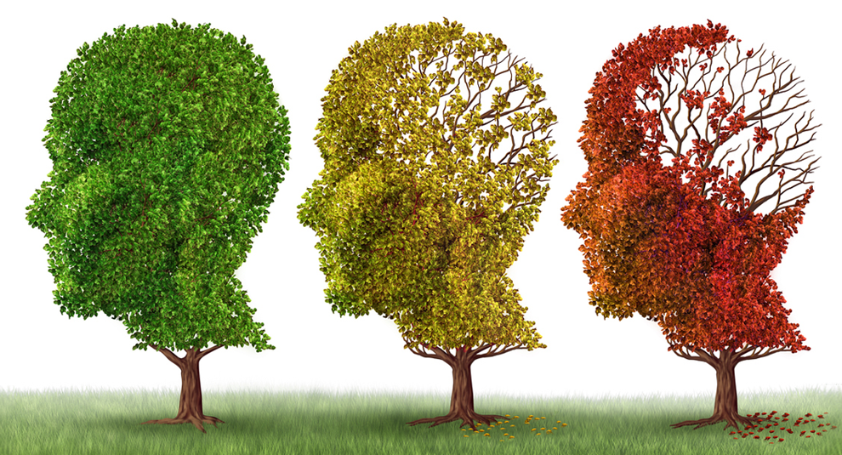
EXPLORATORY DATA ANALYSIS & VISUALIZATION
Understanding the target variable CDR
CDR 0.5 = mild
CDR 1 = moderate
CDR 2 = severe

Slide 9
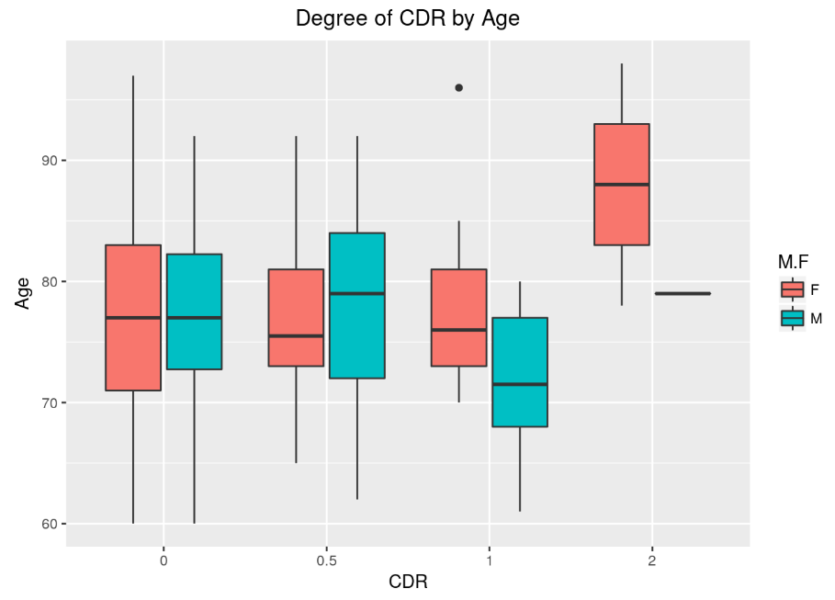
EXPLORATORY DATA ANALYSIS & VISUALIZATION
What influences the target variable CDR
It seems like the medians are the same for CDR=0 and CDR=0.5. While, CDR=1 has the lowest median age.
An oddity is the distribution of CDR=2. It is oddly skewed and inconsistent with the pattern.
3 observations belong to CDR = 2. So, group CDR=1 and CDR=2 are merged.

Slide 10
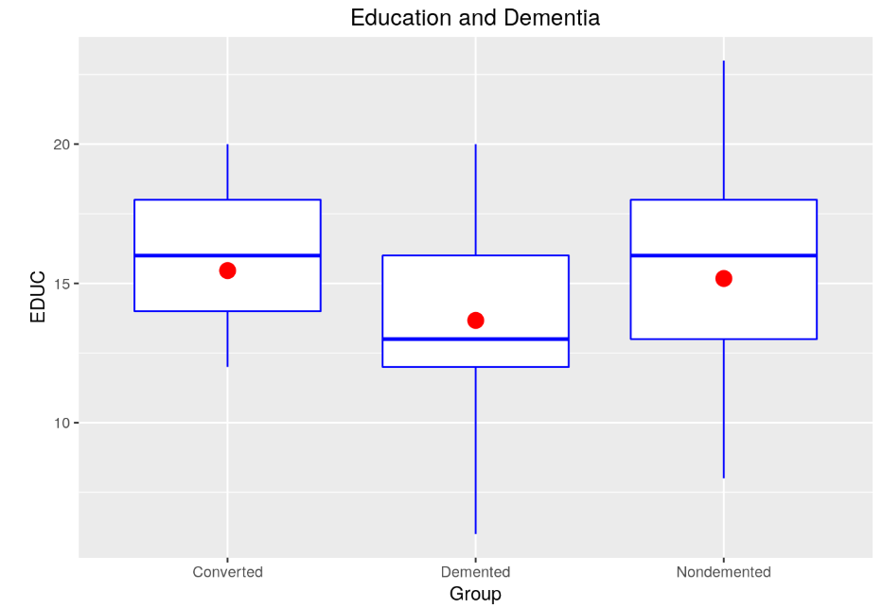

EXPLORATORY DATA ANALYSIS & VISUALIZATION
What influences the target variable CDR
After binning the CDR values, distributions look a lot better.
CDR measures the degree of dementia while Group classifies if a person has dementia or not.
Education Demented
Conduct a Kruskal-Wallis test of medians and an ANOVA of means. The p values for both tests are somewhat low which indicates that there is a difference in medians and means.

Slide 11
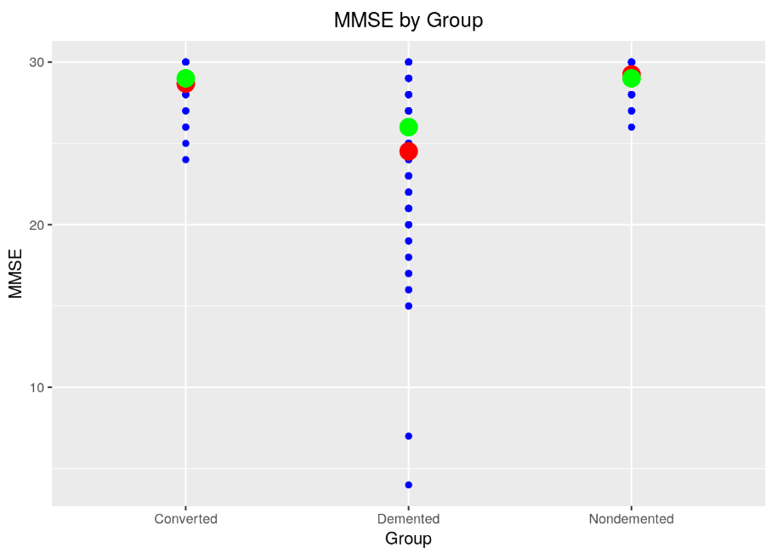
EXPLORATORY DATA ANALYSIS & VISUALIZATION
What influences the target variable CDR
Dot plot with mean (red) and median (green) for each group show that the nondemented group has a higher average and higher median MMSE score.
By further analysis, There is positive correlation between EDUC and MMSE.

Slide 12
PRE-MODELING
Multicollinearity
Center and Scale
It occurs when there are high correlations among predictor variables, leading to unreliable and unstable estimates of regression coefficients.
Picked .75 as a starting point and adjust based on the data. Filtering for correlated predictors drops two variables from the model.
Center and scale all numeric predictors.
Some models benefit from having variables on the same scale.

Slide 13

METHODOLOGY
MODELING
LOGISTIC REGRESSION
KNN
SVM
RANDOM FOREST

Slide 14
MODELING
LOGISTIC REGRESSION
SVM
Use the glmnet method with lasso penalties to fit a logistic regression model with the L1 penalty.
Performed 10 folds cross validation.
The best tune was when λ=.000517 which produces an accuracy of 83%.
It seems that Age, EDUC, SES, and ASF have the largest coefficients.
The best tune is Cost = 8 with accuracy of 86%. Notably better than the logistic regression model previously fitted.
MMSE is by far the most important variable. Second most important is nWBV. Then, sex and EDUC are tied for third.

Slide 15
MODELING
KNN
RANDOM FOREST
The optimal tune is with k=5. This means that when predicting a new point, the five “closest” points determine what the new one will be.
With an accuracy of 81%, there is a drop in performance compared to logistic regression and support vector machine.
Using importance = T and type = 1. Seems like MMSE is most important, followed by nWBV and EDUC.
Very similar to the support vector’s variable importance! Interesting!
The best tune is listed above and has accuracy of 86%.

Slide 16
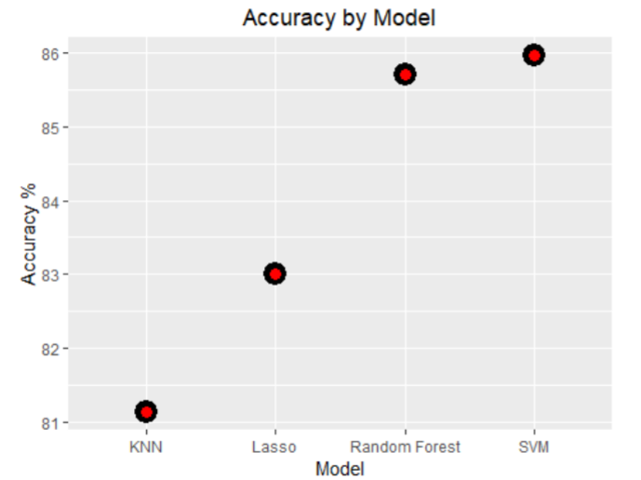
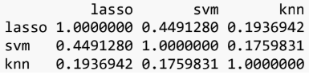
RESULTS AND CONCLUSIONS
Lasso (Logistic) is most correlated with RF and not very correlated with the support vector machine and KNN.
SVM is most correlated with RF, but, 0.57 is not that high of a correlation.
KNN is not strongly correlated with any of the other models.
In terms of individual model performance based on accuracy, we see that the support vector performs the best.

Slide 17
REFERENCES
[1] Neha Surendran1, Ahammed Muneer K (2017),Multistage Classification of Alzheimer’s Disease.

Slide 18
THANK YOU

